Slide 1

Project Title -AIRBND Hotel Booking Analysis
[Student Name:- Tanmay Shashikant Tekawade ]
[AICTE Internship ID:- STU682e2c50c6b951747856464]

Slide 2

PROBLEM STATEMENT
With the rapid growth of short-term rental platforms like Airbnb, travelers have access to thousands of accommodation options across various cities. However, determining the right pricing strategy, understanding customer preferences, and identifying factors that influence booking demand remain major challenges for hosts and property managers.
This project aims to analyze Airbnb booking data to uncover key patterns, relationships, and trends that influence price, availability, and customer satisfaction. Through data analysis and visualization, the study provides insights that can help hosts optimize pricing strategies, improve occupancy rates, and enhance overall guest experience.

Slide 3
Project Description
The Airbnb Hotel Booking Analysis project focuses on exploring and understanding the factors that affect the pricing, popularity, and availability of Airbnb listings. Using real-world Airbnb open data, this analysis applies Python-based data analytics and visualization techniques to extract meaningful insights from large datasets.
The project involves cleaning and preprocessing raw Airbnb data, performing exploratory data analysis (EDA), visualizing trends in pricing, room types, and locations, and identifying correlations among key variables such as reviews, availability, and host behavior.
Machine learning models are further implemented to predict property prices and discover hidden patterns that can help hosts and travelers make informed decisions.
This project not only demonstrates proficiency in Python data analysis tools (like Pandas, Matplotlib, Seaborn, and Scikit-Learn) but also shows how data-driven insights can support business intelligence in the hospitality industry.

Slide 4

WHO ARE THE END USERS?
Airbnb Hosts / Property Owners
To understand how various factors (location, room type, reviews, amenities) affect pricing and bookings.
To optimize listing strategies and set competitive prices.
Travelers / Guests
To identify budget-friendly and high-rated accommodations.
To make informed booking decisions based on data-driven insights.
Airbnb Management / Platform Analysts
To analyze platform-wide trends and improve recommendation algorithms.
To enhance customer satisfaction and host engagement.
Tourism Boards & Market Researchers
To study tourism demand patterns across regions.
To support local businesses and optimize regional travel strategies.
Data Scientists / Analysts
To explore real-world datasets for building predictive and analytical models.
To gain insights into business intelligence and hospitality analytics.

Slide 5

Technology Used
Programming & Analysis
Python – Core language for data analysis and machine learning
Jupyter Notebook – For code development, visualization, and analysis
Libraries & Frameworks
Pandas – Data cleaning and preprocessing
NumPy – Numerical computations
Matplotlib / Seaborn – Data visualization and insights
Scikit-learn (sklearn) – Machine learning models (Linear Regression, Random Forest)
Joblib – Model saving and loading
Dataset & Tools
Airbnb Open Dataset (.xlsx) – Source of real-world data
Excel / CSV – Data storage and preprocessing formats

Slide 6
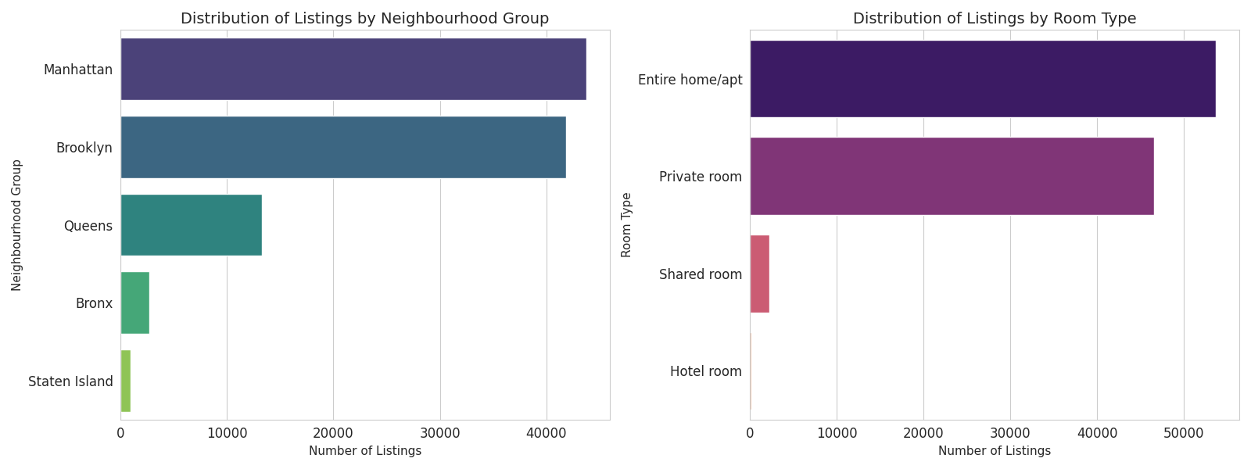
RESULTS1

Slide 7
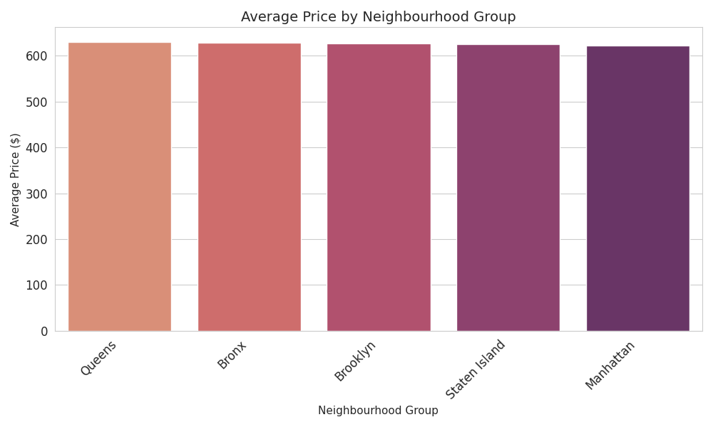
RESULTS2
Demo Link

Slide 8
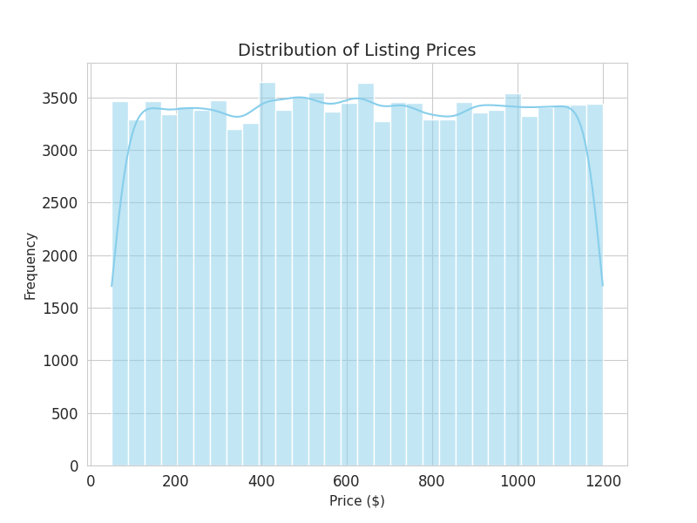
RESULTS3
Demo Link

Slide 9
GitHub repository
Repository Name:- VOIS_AICTE_Oct2025_Tanmay-Tekawade
https://github.com/the-aibytes/VOIS_AICTE_Oct2025_Tanmay-Tekawade

Slide 10
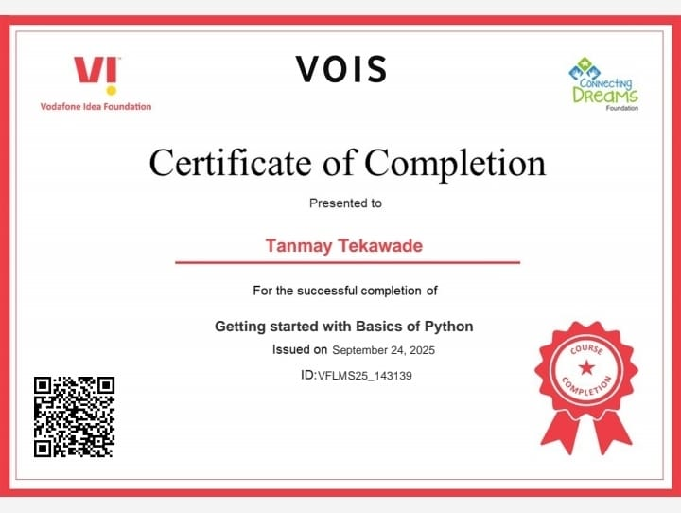
Getting started with Basics of Python Certificate

Slide 11
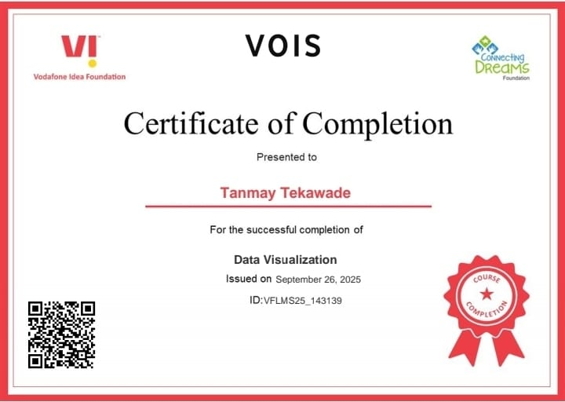
Data Visualization Certificate

Slide 12
Thank you
.
.

